Slide 1
Austin Kart

Slide 2
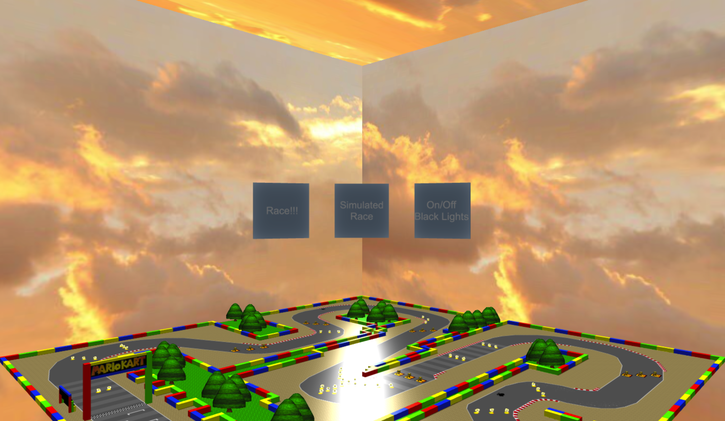
Features used:
Ground
Found online
Used to put everything in the right place
1024x1024

Slide 3
Features used:
Buttons
3D
Holographic
Rotated
Sphere Panel
Sizing
SkyBox
Very Large
Not Infinite

Slide 4
Features used:
Walls
Each segment is 8 blocks long
Made using function with Parameters: startColor, startPosition, endPosition, constPosition, constAxis

Slide 5
Features used:
Trees
All are sprites
Generated randomly
Between two diagonal points
Resized for track size

Slide 6
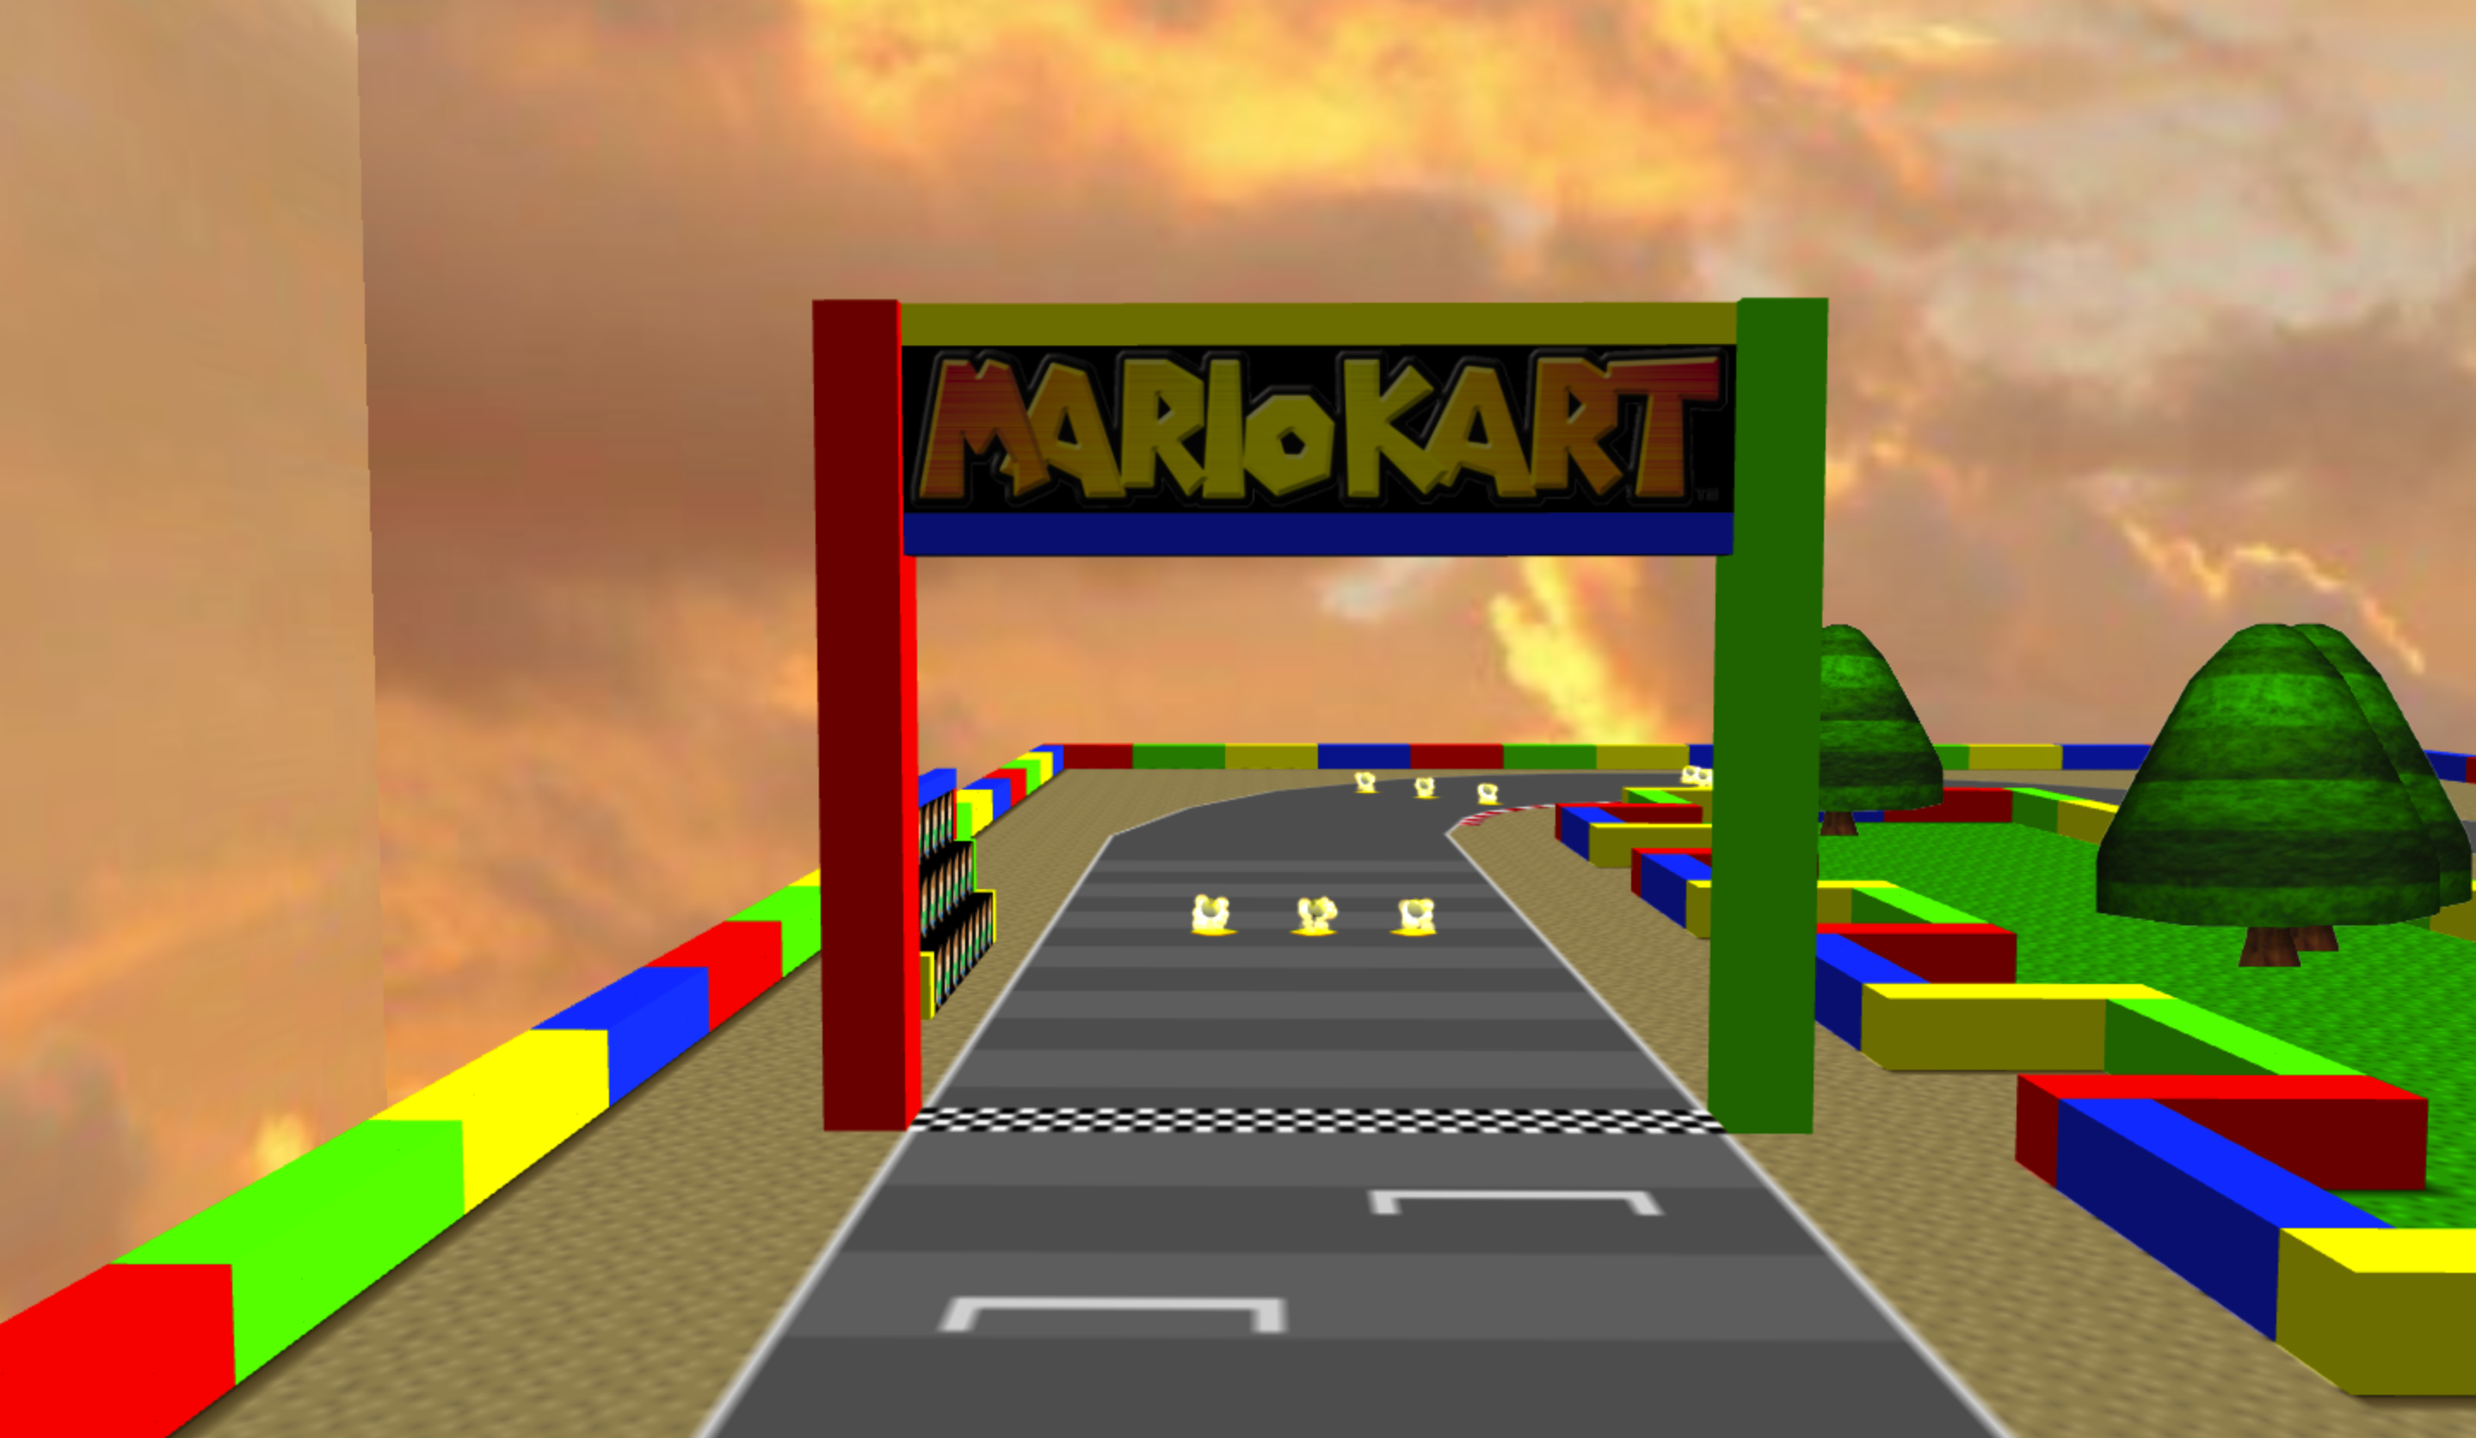
Features used:
Finish Line
Two plains opposite each other
Graphic found online

Slide 7
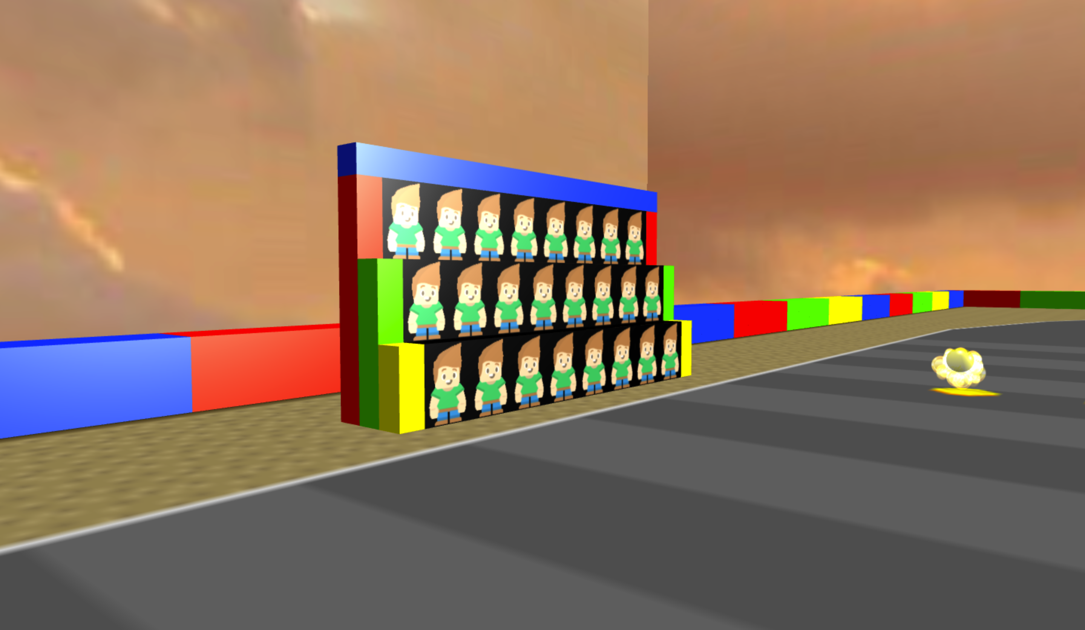
Features used:
Bleachers
Sprites stay on surface
Animated

Slide 8
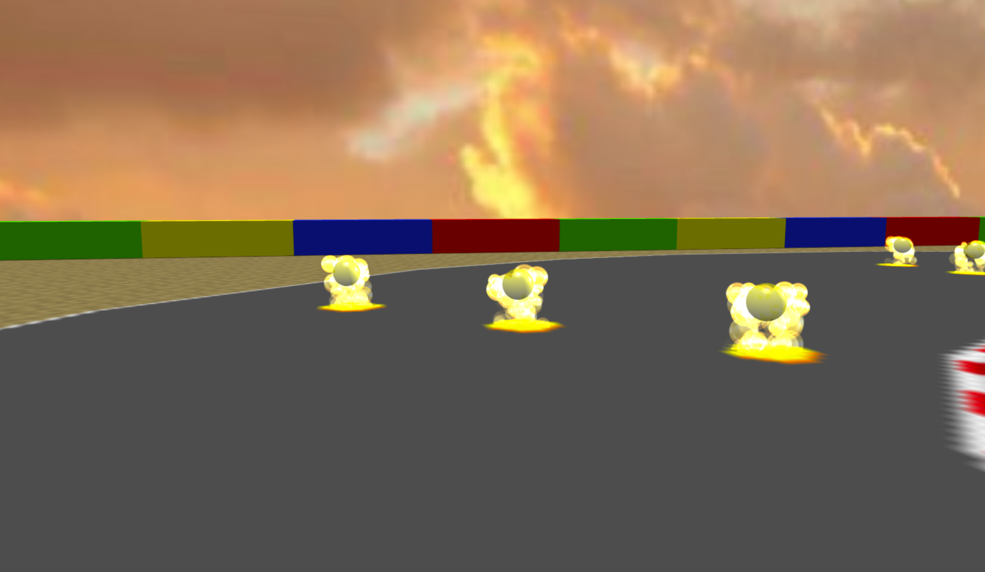
Features used:
Coins
Sphere
Fountain
Opacity

Slide 9
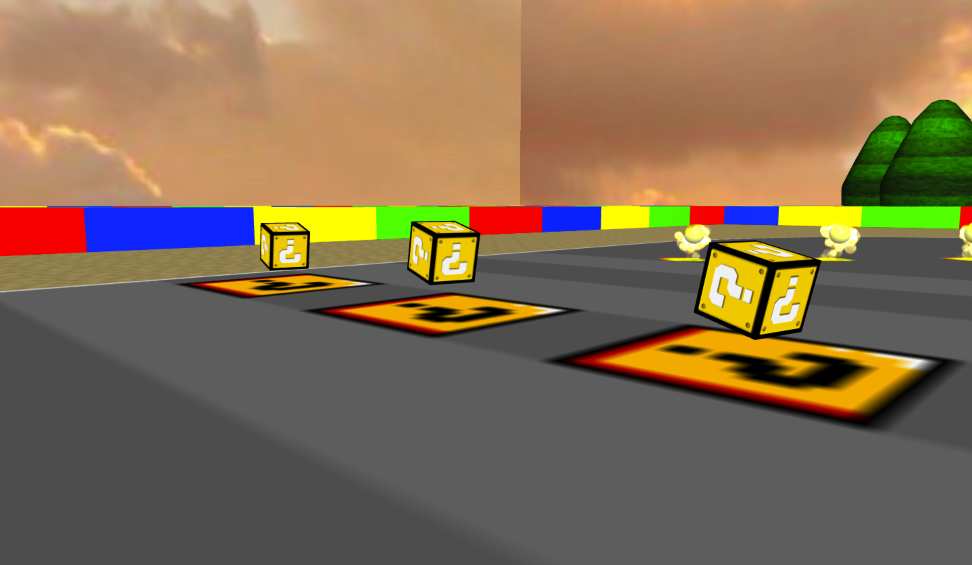
Features used:
Question Boxes
Complex Animation
Spinning
Rotating
Texture found online
Map and rotate texture

Slide 10
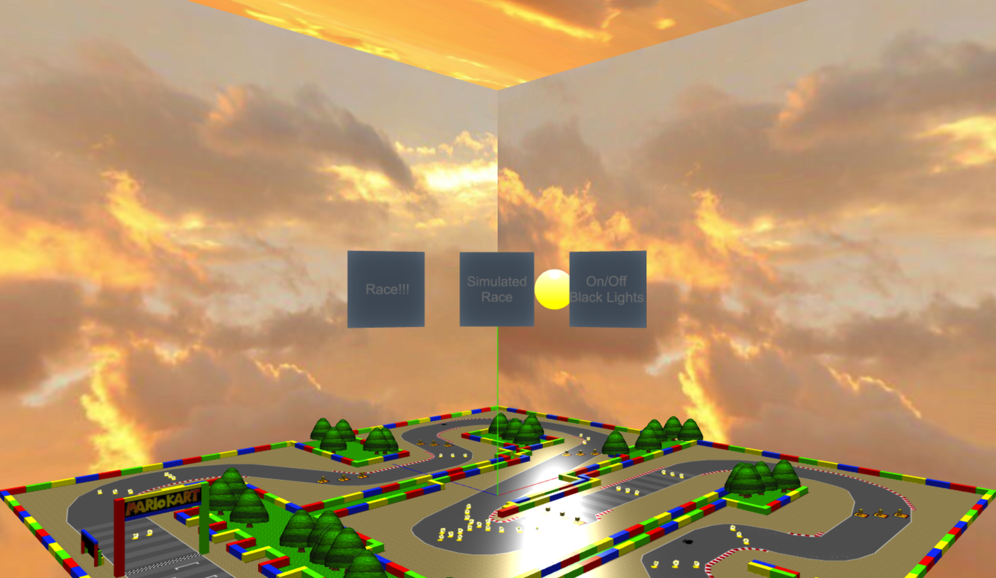

Slide 11
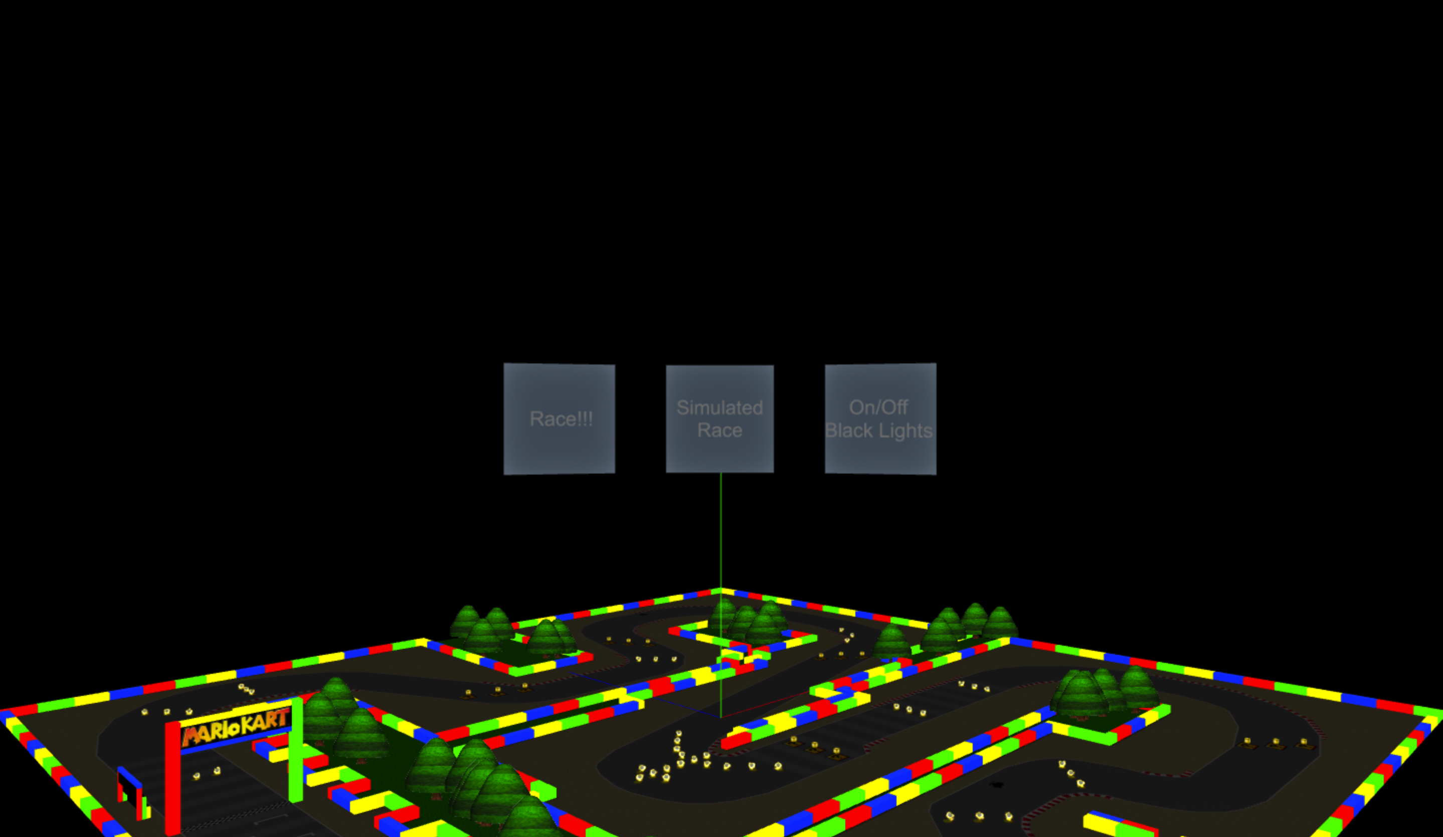
Features used:
Emissive Lights
Boxes
Finish Line
Bleachers
Sprites
Coins
Boxes
Ground

Slide 12
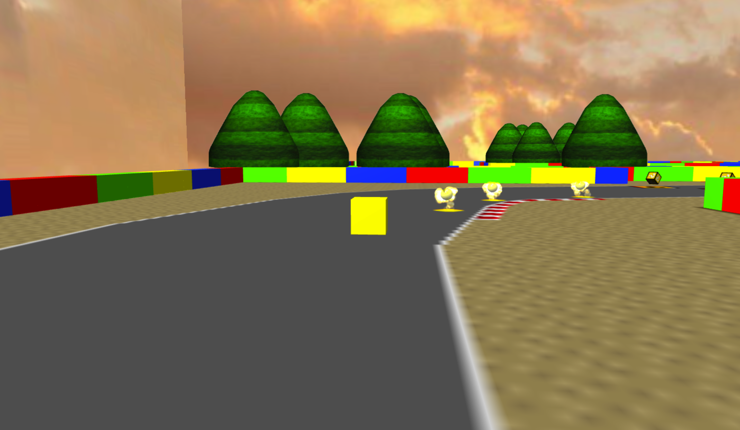
Features used:
Follow Camera
Following “Kart”
Modified speed of Kart

